Slide 1
Short note on Zener Diode as a Voltage Regulator
Zener Diode is engineered in a way that it operates in a reverse biassed mode when the breakdown region is reached. It is used as a voltage regulator because it can provide a stable voltage for a broad range of current.
Zener Diode
A Zener diode is a super doped p-n junction diode that can operate in both forward and reverse bias. When it is operating in the forward bias, it is just like any other diode. Its main use is in reverse biassed mode, wherein the direction of current is reversed.
Now, most diodes are designed in a way that once a reverse voltage reaches its limit, then the diode stops functioning. So is not the case with Zener diodes. Their breakdown region is at a lower value and once that is reached, it starts conducting electricity in the reverse direction.
In the reverse biassed mode, the n-type is connected to the negative terminal and the p-type is connected to the positive terminal. When the potential across the ends is reversed and Zener voltage is reached, the p-n junction breaks down and the current starts flowing in the opposite direction.
While talking about Zener diodes, it is most crucial to understand its breakdown region. There are two breakdown regions that exist – avalanche breakdown and Zener breakdown.

Slide 2
Avalanche Breakdown
When the reverse voltage is applied, the depletion layer of the Zener diode starts to widen. As the value of reverse voltage increases, the width of the depletion layer also keeps on increasing. In the presence of a strong electric field, the minority carriers gain kinetic energy. As the kinetic energy keeps on increasing, electrons start colliding with other ions in the depletion layer. In the process, more free electrons are knocked out, which further collide with ions and knock out even more free electrons.
There is a sudden spike in the number and movement of free electrons in the depletion layer. This implies that there is a spike in the conductance value. At one point, known as the avalanche breakdown, there is a sharp increase in electrical conductance.
Any normal diode would not be able to tolerate such a massive spike in current within a short interval. However, the Zener diode is designed to tolerate it and to conduct electricity at high reverse potential values.

Slide 3
Zener Breakdown
Avalanche breakdown happens at a higher voltage value and is not very sharp. The sharper breakdown region is that of Zener breakdown and it happens at a lower reverse potential value. As mentioned above, the Zener diode is a heavily doped diode. That means the concentration of impurities in the depletion layer is much higher.
Hence, for a given value of reverse potential, the number of ions in a Zener diode would be higher as compared to that in a normal diode. Hence, the depletion layer in the Zener diode is thinner. Having a thinner depletion layer implies a higher electric field strength or higher voltage gradient. After a given point, the electrons break free from the covalent bonds and start conducting electricity. This breakdown region is known as the Zener breakdown. Zener voltage refers to the voltage at which it occurs.

Slide 4
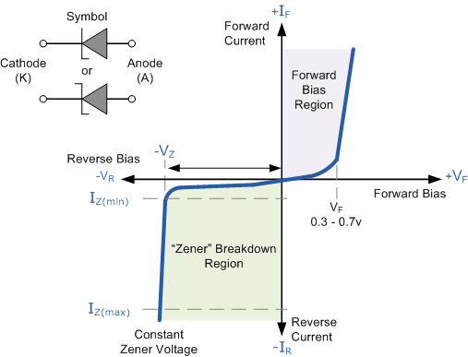
I-V Plot for Zener diode

Slide 5
Use of Zener diode As a voltage regulator
The Zener diode has the characteristic that its voltage remains constant over a broad range of electric currents. A voltage regulator is called so because it can regulate the electrical voltage across a circuit. It ensures that the input voltage stays constant throughout the entire time period of supply. Thanks to the Zener diode, the value of voltage does not drop and remains constant even when a high power load is applied. This is a problem that used to occur a lot in olden times and still happens in rural areas.
In an electrical circuit, the Zener diode is applied in parallel with the load. A resistor is connected in series with the diode to limit the supply of electrical current across the diode. The cathode is connected to the positive terminal of the battery (or cell) and the anode is connected to the negative terminal.
Zener diodes are used in computers to ensure that there are no major voltage fluctuations as the computer machinery can be harmed if that happens. There is also a risk of fire in case of a sudden rise in voltage level.
Zener diodes are also used in power generators to ensure a steady voltage supply.

Slide 6
Zener Diode as a Voltage Regulator
There is a series resistor connected to the circuit in order to limit the current into the diode. It is connected to the positive terminal of the d.c. It works in such a way the reverse-biased can also work in breakdown conditions. We do not use ordinary junction diode because the low power rating diode can get damaged when we apply reverse bias above its breakdown voltage. When the minimum input voltage and the maximum load current is applied, the Zener diode current should always be minimum.
Since the input voltage and the required output voltage is known, it is easier to choose a Zener diode with a voltage approximately equal to the load voltage, i.e. VZ = VL.
Following is the link explaining the difference between Zener breakdown and Avalanche breakdown:

Slide 7
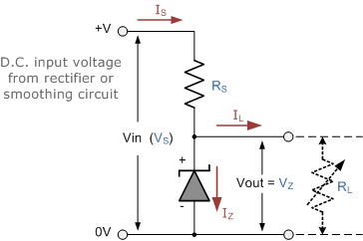
Zener Diode Regulator
Resistor, R_{S} is connected in series with the zener diode to limit the current flow through the diode with the voltage source, V_{S} being connected across the combination. The stabilised output voltage V_{out} is taken from across the zener diode.

Slide 8
The zener diode is connected with its cathode terminal connected to the positive rail of the DC supply so it is reverse biased and will be operating in its breakdown condition. Resistor R_{S} is selected so to limit the maximum current flowing in the circuit.
With no load connected to the circuit, the load current will be zero, ( I_{L} = 0 ), and all the circuit current passes through the zener diode which in turn dissipates its maximum power.
Also a small value of the series resistor R_{S} will result in a greater diode current when the load resistance R_{L} is connected and large as this will increase the power dissipation requirement of the diode so care must be taken when selecting the appropriate value of series resistance so that the zener’s maximum power rating is not exceeded under this no-load or high-impedance condition.

Slide 9
The load is connected in parallel with the zener diode, so the voltage across R_{L} is always the same as the zener voltage, ( V_{R} = V_{Z} ).
There is a minimum zener current for which the stabilisation of the voltage is effective and the zener current must stay above this value operating under load within its breakdown region at all times. The upper limit of current is of course dependant upon the power rating of the device. The supply voltage V_{S} must be greater than V_{Z}.
One small problem with zener diode stabiliser circuits is that the diode can sometimes generate electrical noise on top of the DC supply as it tries to stabilise the voltage. Normally this is not a problem for most applications but the addition of a large value decoupling capacitor across the zener’s output may be required to give additional smoothing.

Slide 10
The load is connected in parallel with the zener diode, so the voltage across R_{L} is always the same as the zener voltage, ( V_{R} = V_{Z} ).
There is a minimum zener current for which the stabilisation of the voltage is effective and the zener current must stay above this value operating under load within its breakdown region at all times. The upper limit of current is of course dependant upon the power rating of the device. The supply voltage V_{S} must be greater than V_{Z}.
One small problem with zener diode stabiliser circuits is that the diode can sometimes generate electrical noise on top of the DC supply as it tries to stabilise the voltage. Normally this is not a problem for most applications but the addition of a large value decoupling capacitor across the zener’s output may be required to give additional smoothing.

Slide 11
Then to summarise a little. A zener diode is always operated in its reverse biased condition. As such a simple voltage regulator circuit can be designed using a zener diode to maintain a constant DC output voltage across the load in spite of variations in the input voltage or changes in the load current.
The zener voltage regulator consists of a current limiting resistor R_{S} connected in series with the input voltage V_{S} with the zener diode connected in parallel with the load R_{L} in this reverse biased condition. The stabilised output voltage is always selected to be the same as the breakdown voltage V_{Z} of the diode.

